Slide 1

A RATHNA KAMAL’S WRITINGS
PRESENTS
STOICHKOV’S
CASE
AN INVESTIGATIVE FILE
CHAPTER 2 - VARIABLES AND CONSTANT

Slide 2
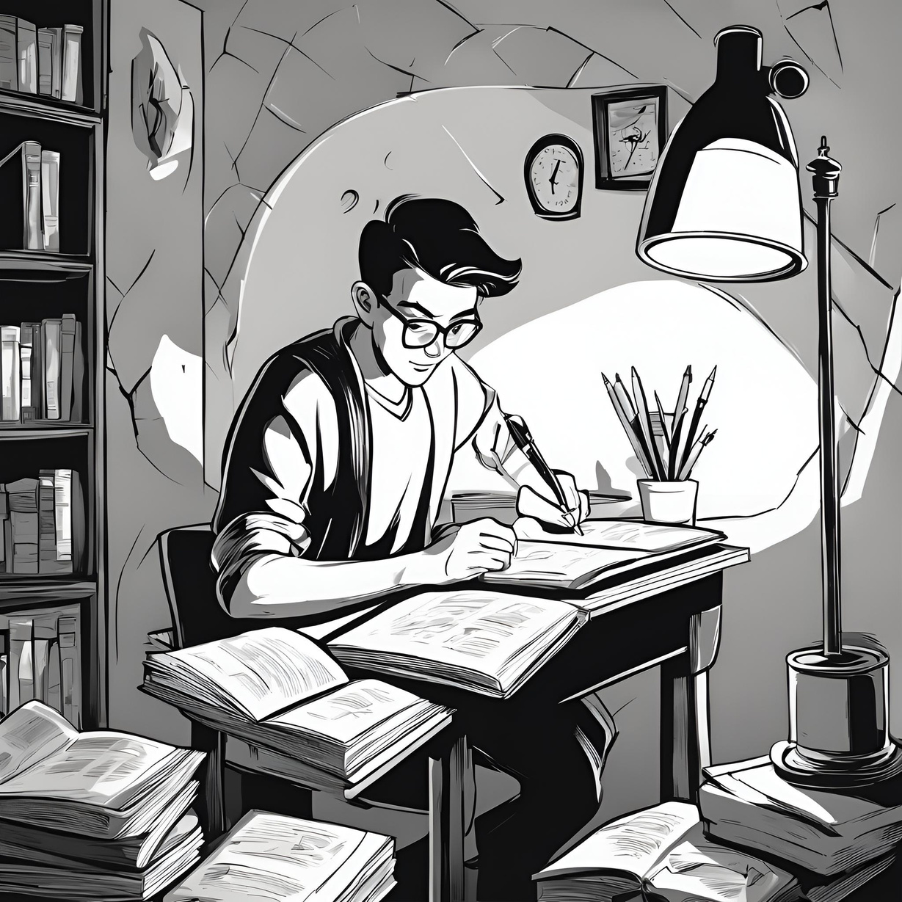

HELLO THERE!
My name is Jonnalagadda Rathna kamal; An aspiring Story writer and have a keen eye for creative regarding quest development and designing it. This is my story application in regards to joining in your company” CD Projekt RED” as an ‘Intern’ in Quest designing and Development.
If you like my Story or my application, we can talk it over and can move forward with next step, thank you.

Slide 3


This is the Continuation of Chapter 1; which gives us an idea on what and “who is up against who”.
The story presented is made of fiction inspired by true events, if there are any kind of resemblances to the real world in the form of names , places, things; those are purely coincidental and not by means referring to any real life characters; Thank you.
P.S. (Madam Anna Krawczyk If you had read Chapter 1 ; I hope that you will enjoy this one even more, Sorry for any inconvenience.)

Slide 4
The Given PPT will be a read-only File due to patent Issues. The slide show will be in it’s best format form so that you the “Reader” can enjoy.
Thank you.
-Rathna Kamal.

Slide 5
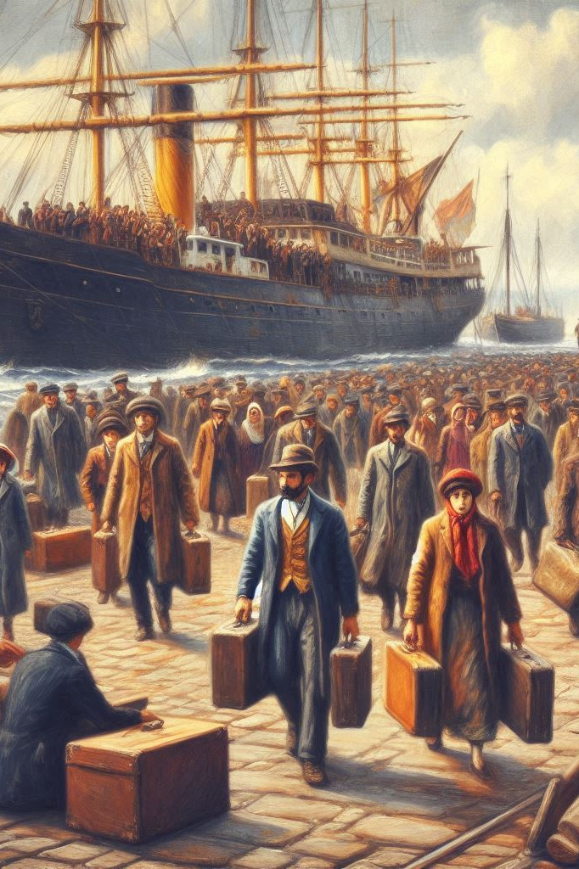
Variables
“Don Paul Macheavelli” arrived in the late 90's from Sicily along with his wife, for a glorious future for him and his family. He started to work as a contract labor in the shipyard he arrived on the eastside.
Due to low wages and hazardous work conditions for the labors working, paulie formed a ‘Workers union’ to fight back against the government so that “They and their brothers and sisters who are immigrants came to the land can live without any one looking down on them and their work and the government must take care of us”.
In short he won and created a new union just for the immigrants like him so that they can live happily in this ‘God’s country’ Known as ‘Alcantranz’

Slide 6
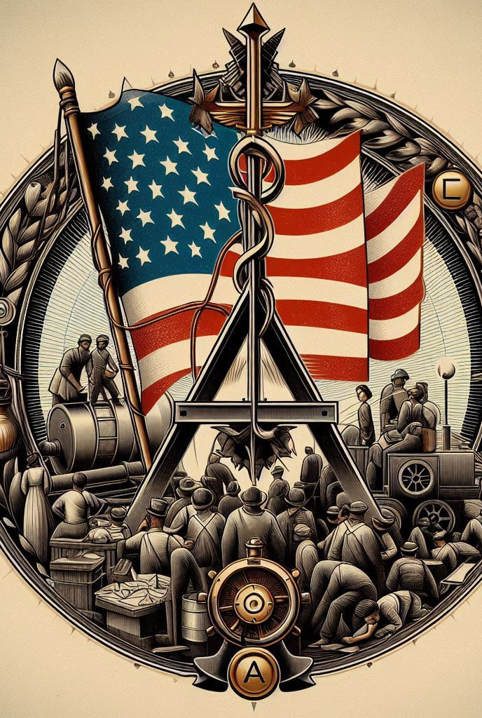
At first the Union worked for the immigrants, took care of their problems, fought against everything that would cause problems for the immigrants in any form.
But, nothing in this city lasts forever especially if it is “good for the people”. Slowly the union started to deal with the wrong people of wrong nature and turned against everything it stood for and became the mafia gang it is today.
Paulie who became the leader of the Union had 2 sons Damon and Simon.
Damon, the elder one, went back to Sicily to take care of the family lands and agricultural farming, while Simon, the younger one, stayed back and started to run the union his father started,

Slide 7
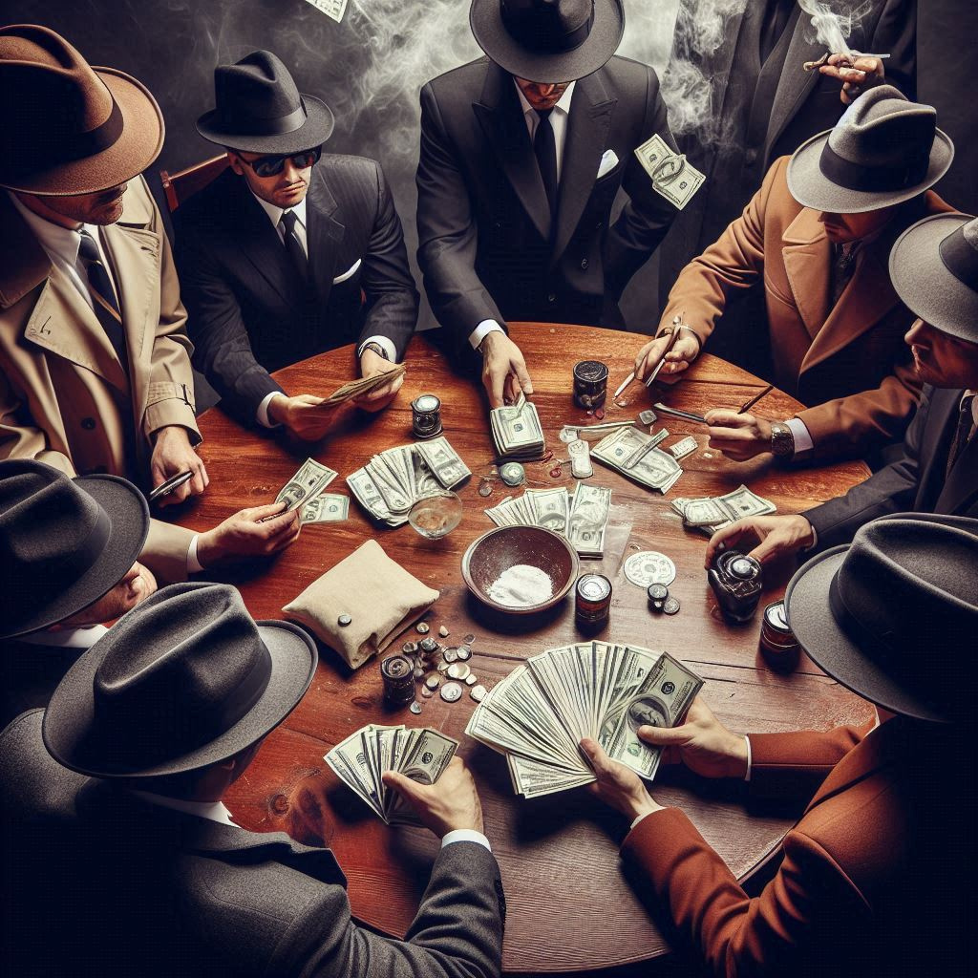
Simon wanted more than what the union is producing, he wanted to run the city and to do that he wanted to control everything; rackets, dope business, money laundering, trafficking you name it. all kinds of illegal business were either handed over or taken by force by the new Alcantranz mafia. With that money and help from his political buddies.
Simon became invincible to the government as the Mayor ‘Steve didtmond’ and the D.A. ‘William spears’ along with a few other political people he kept under his thumb.
I took my charges 3 years ago and this bastard’s file did not even have more than 2 pages, Still he keeps men and women like me alive and working, to make people believe that he is not a tyrant but a peace loving and helpful man just like his father and if any one starts asking questions and starts going after him; you know what’s going happen to them.
Six-feet underground; Some fucking narcissist.

Slide 8
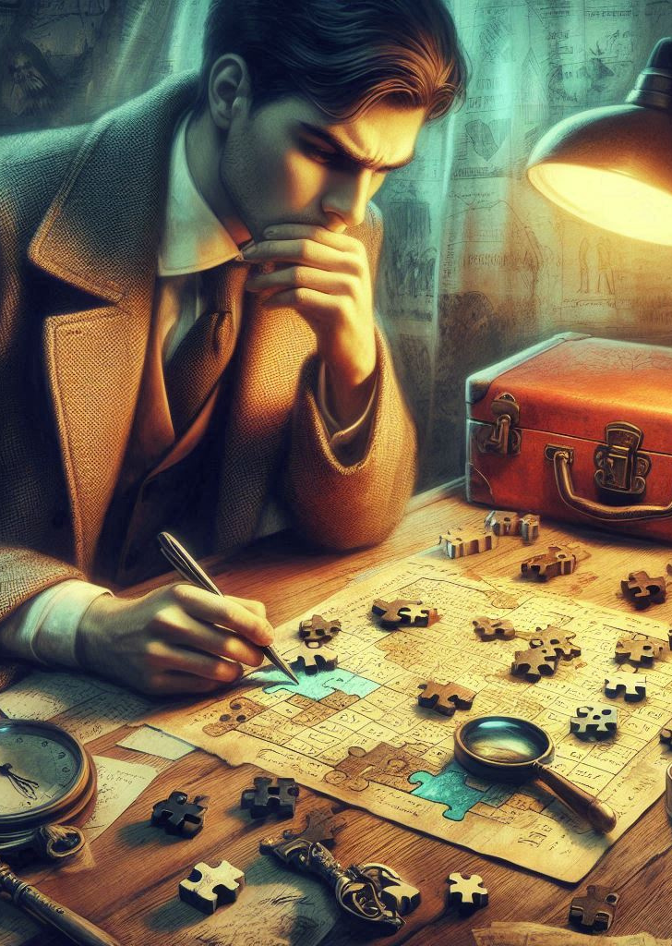
CONSTANT
“Alexander Bell” Father: Unknown, Mother: Unknown, Place of Birth: Unknown.
“Alex” is a curious case, he joined us six months ago while completing his degree in Psychology along with computer science in Oxford University. He rarely speaks about his family; whoever his father might be, that likes telephones a lot.
He is one of the few brilliant people I have seen in my entire career; Since he joined, the total cases he solved were ‘29’. For a rookie to have a number like that is astonishing and every case he solved is bigger than the previous; Drugs, money anything, there is not a single bust in this city in which Alex's hand is not present.
Which makes him the perfect hero portrayed in the anime cartoons Right?.......

Slide 9

WRONG!
THAT GUY IS THE WORST DETECTIVE THIS COUNTRY HAS EVER SEEN.
MORE THAN 30 CHARGES AGAINST HIM REGARDING OVERSPEED, KILLING WITHOUT ANY GIVEN PERMISSIONS, DEALING WITH DRUGDEALERS ON DUTY, HAVING SEXUAL AFFAIRS WITH EVERY WOMAN HE MEETS, EVEN WITH HIS CO-WORKING WOMEN TOO, ON DUTY BY THE WAY, ALWAYS CARRIES HIS CUSTOM PISTOL WEARING BLACK COATS AND RIDING ON HIS STUPID BIKE WHICH HAS NITRO, I MEAN WHO THE FUCK HAS NITRO TO HIS BIKE. DOES NOT GIVE AN OUNCE OF RESPECT TO HIS SUPERIOR OFFICERS EVEN TO ME!!!.
I am sorry…. I went a little bit off…. that guy, I mean he is the ‘Best’ and the ‘worst’ of a kind.

Slide 10

But then Alex never took a single bribe from anyone, Doesn’t Drink or smoke which might make him a ‘Saint’ cop to others , But people who knew him; that’s a whole different matter entirely.
That brings;
We have a young detective who do not gives a shitfuck about the people around him or the society he lives on one side and on the other we have mob who wants to control everything in the society they live in and now both of them are heading towards collision.
Seems like a good B-line action movie but the dead ones say otherwise.
Which leaves ;
Why did Alex went after the Don’s son?, What’s between them?,
What is the connection that links these two Different aspects together?.......
Maybe?.. Maybe....... That might be the reason, that’s the equation,
Ha hahaahaaaaa(The Don Smiles)....
Case Continues.

Slide 11

I hope the story meet your requirements, If or If not Thank you for taking time to read My short story; I have much more if you needed. Best Regards.
- Rathna kamal

Slide 12

CONTACT
EMAIL
Rathnakamaljonnalagadda2004@gmail.com

Slide 13
THANK YOU!
HAVE A WONDERFUL DAY AND A GLORIOUS LIFE.

